Slide 1
Review & Complement
Hung-yi Lee
Notes:
Rank 的特性有好多 ……

Slide 2
Announcement
4/20 (下下週三) 期中考
範圍: 到第四章 (有*章節不考)
下週三、週四複習
把想問的問題、想講解的習題、想講解的章節在下週二午夜前讓老師知道
勾選習題
http://speech.ee.ntu.edu.tw/~tlkagk/courses/LA_2016/Lecture/problem.pdf

Slide 3
More about Rank
Notes:
Rank 的特性有好多 ……

Slide 4
Review: Rank A
Maximum number of Independent Columns
Number of Pivot Columns
Number of Non-zero rows
Number of Basic Variables
Dim (Col A) = Dim (Row A) = Dim (Col A^{T})
Dimension of the range of function A

Slide 5
Properties of Rank
A is a m x n matrix.
A is said to have full rank if Rank A = m or Rank A = n.
A is said to be rank deficient if it does not have full rank.
Rank A = Rank A^{T}
$Rank A ≤$ min( m , n )

Slide 6
Properties of Rank
If A is a m x n matrix, and B is a n x k matrix.
If B is a matrix of rank n, then
If A is a matrix of rank n, then
$$Rank\left(AB\right)≤min\left(Rank\left(A\right),Rank\left(B\right)\right)$$
$$Rank\left(AB\right)=Rank\left(A\right)$$
$$Rank\left(AB\right)=Rank\left(B\right)$$

Slide 7
Properties of Rank
If A is a m x n matrix, and B is a n x k matrix.
If A is a m x n matrix, and Q is a m x m invertible matrix.
$$Rank\left(AB\right)≤Rank\left(A\right)$$
$$Rank\left(QA\right)=Rank\left(A\right)$$
Invertible matrix is a product of elementary matrices.
Elementary row operation will not change the row space
dim of row space
Rank
Notes:
Any matrix multiplied by an invertible matrix will not change its rank.

Slide 8
Properties of Rank
If A is a m x n matrix, and B is a n x k matrix.
$$Rank\left(AB\right)≤Rank\left(A\right)$$
$$PA=R$$
$$Rank\left(AB\right)$$
$$=Rank\left(PAB\right)$$
$$=Rank\left(RB\right)$$
P is an invertible matrix
$$Rank\left(A\right)$$
$$=Rank\left(PA\right)$$
$$=Rank\left(R\right)$$
?
It can also have zero rows
$$Rank\left(R\right)$$
=
$$R$$
$$B$$

Slide 9
Properties of Rank
If A is a m x n matrix, and B is a n x k matrix.
If B is a matrix of rank n, then $Rank\left(AB\right)=Rank\left(A\right)$
If A is a matrix of rank n, then $Rank\left(AB\right)=Rank\left(B\right)$
$$Rank\left(AB\right)≤Rank\left(A\right)$$
$$Rank\left(AB\right)≤Rank\left(B\right)$$
$$Rank\left(AB\right)=Rank\left(B^{T}A^{T}\right)$$
$$≤Rank\left(B^{T}\right)$$
$$=Rank\left(B\right)$$
$$Rank\left(A^{T}\right)=n=Rank\left(A\right)$$

Slide 10
Theorem 4.9 (P258)
If V and W are subspaces of R^{n} with V contained in W, then dim V $≤$ dim W
If dim V = dim W, V=W
Proof:
B_{V} is a basis of V, V in W, B_{V} in W
B_{V} is an independent set in W
By extension theorem, B_{V} is in the basis of W
dim V $≤$ dim W
If dim V = dim W =k
B_{V} is a linear independent set in W, with k elements
It is also the span of W

Slide 11
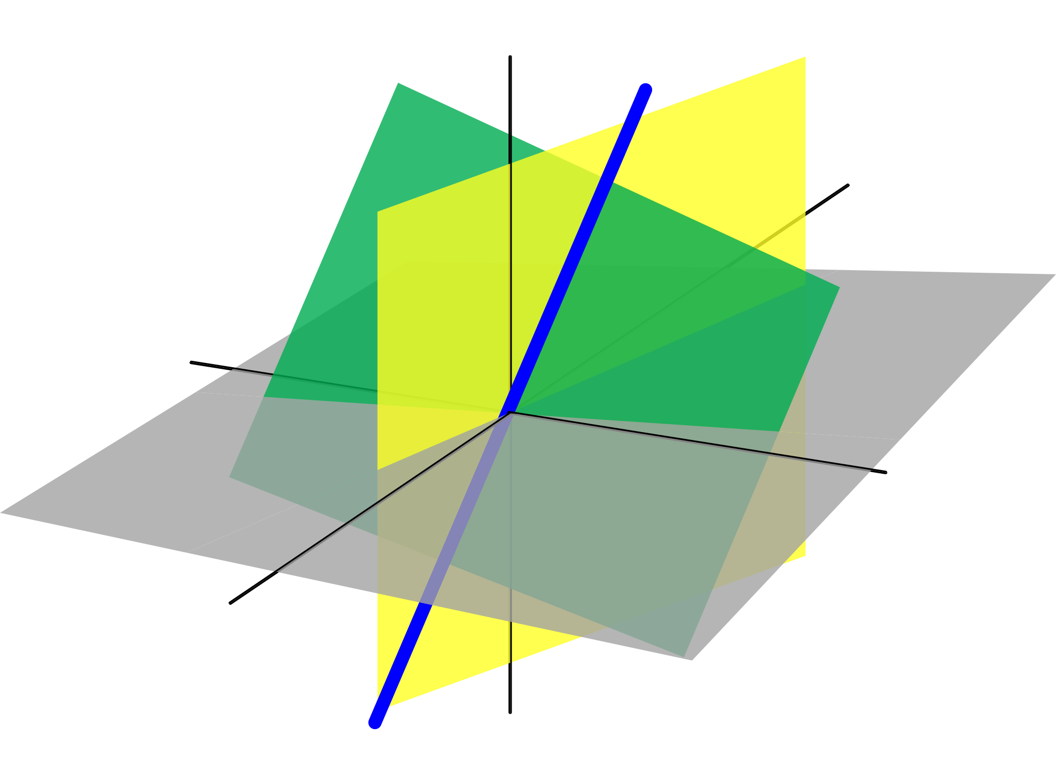
R³ is the only 3-dim subspace of itself
L
W
The 2-dim subspace with basis {u,v}
u
The 0-dim subspace
v
0
The 1-dim subspace with basis {u}

Slide 12
Properties of Rank
If A is a m x n matrix, and B is a n x k matrix.
$$Rank\left(AB\right)≤Rank\left(A\right)$$
$$Rank\left(A\right)$$
A
B
$$Rank\left(AB\right)$$
$$R^{m}$$
$$R^{n}$$
$$Rank\left(B\right)$$
$$R^{k}$$
HW: Proof $Rank\left(A+B\right)≤Rank\left(A\right)+Rank\left(B\right)$
Notes:
Interesting fact

Slide 13
Properties of Rank
$$Rank\left(AB\right)≤min\left(Rank\left(A\right),Rank\left(B\right)\right)$$
T
……
……
$$T\left(b_{1}\right)$$
$$T\left(b_{2}\right)$$
$$T\left(b_{k}\right)$$
$$b_{1}$$
$$b_{2}$$
$$b_{k}$$
Dependent
Independent

Slide 14
More about Determinants

Slide 15
Properties of Determinants
Basic Property 1: $det\left(I\right)=1$
Basic Property 2: Exchange rows reverse the sign of det
If a matrix A has 2 equal rows, det A = 0
Basic Property 3: Determinant is “linear” for each row
A row of zeros, det A = 0
$$det\left(\left[\begin{matrix}ta & tb \\ c & d\end{matrix}\right]\right)=tdet\left(\left[\begin{matrix}a & b \\ c & d\end{matrix}\right]\right)$$
$$det\left(\left[\begin{matrix}a+a′ & b+b′ \\ c & d\end{matrix}\right]\right)=det\left(\left[\begin{matrix}a & b \\ c & d\end{matrix}\right]\right)+det\left(\left[\begin{matrix}a′ & b′ \\ c & d\end{matrix}\right]\right)$$
A is invertible
det(A) ≠ 0

Slide 16

Properties of Determinants
$det\left(AB\right)=det\left(A\right)det\left(B\right)$
Proof:
If A is not invertible:
A is not invertible
AB is not invertible
det AB = 0
A is not invertible
det A = 0
det A det B = 0

Slide 17
Properties of Determinants
$det\left(AB\right)=det\left(A\right)det\left(B\right)$
Proof:
You have to proof that det EA = det E det A
If A is invertible:
$$A=E_{k}⋯E_{2}E_{1}$$
(E is elementary matrix)
$$det\left(A\right)=det\left(E_{k}\right)⋯det\left(E_{2}\right)det\left(E_{1}\right)$$
$$det\left(A\right)det\left(B\right)$$
$$=det\left(E_{k}\right)⋯det\left(E_{2}\right)det\left(E_{1}\right)det\left(B\right)$$
$$=det\left(E_{k}\right)⋯det\left(E_{2}\right)det\left(E_{1}B\right)$$
$$=det\left(E_{k}⋯E_{2}E_{1}B\right)$$
$$=det\left(AB\right)$$

Slide 18
Properties of Determinants
det E = det E^{T} …… in the textbook
det A = det A^{T}
Proof:
$$detA=\sum{±n!terms }$$
Format of each term:
$$a_{1α}a_{2β}a_{3γ}⋯a_{nω}$$
Sorted by column indices
Find an element in each row
permutation of 1,2, …, n
Format of each term:
$$a_{α^{′}1}a_{β^{′}2}a_{γ^{′}3}⋯a_{ω^{′}n}$$
Find an element in each column
permutation of 1,2, …, n

Slide 19
A v.s. A^{T}
Rank A = Rank A^{T}
det A = det A^{T}
趙靈兒
林月如
阿奴
趙林阿靈月奴兒如
$$A=$$
$$A^{T}=$$
Name A = Name A^{T}

Slide 20
Dependent and Independent Set

Slide 21
Properties (P81)
For vector sets with one vector $\left\{u\right\}$:
For vector sets with two vector $\left\{u_{1},u_{2}\right\}$:
For a vector set with three vector $\left\{e_{1},e_{2},e_{1}+e_{2}\right\}$
$$u≠0$$
dependent
$$u=0$$
independent
$$u_{1}=0$$
or
$$u_{2}=0$$
$u_{2}$ is a multiple of $u_{1}$
dependent
dependent
dependent

Slide 22
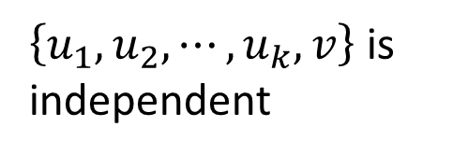
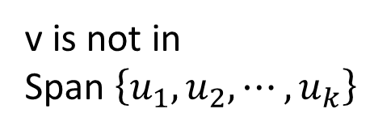
Properties (P81)
Let $\left\{u_{1},u_{2},⋯,u_{k}\right\}$ is independent
Every vector set of R^{n} containing more than n vectors must be dependent.
If no vector can be removed from vector set S without changing its span, S is independent.
Theorem 1.9 (yourself)
v is not in
Span $\left\{u_{1},u_{2},⋯,u_{k}\right\}$
$\left\{u_{1},u_{2},⋯,u_{k},v\right\}$ is independent
Notes:
I have question about 5 ….

Slide 23
Rotation Matrix

Slide 24
Rotation Matrix
$$T_{θ}\left(e_{1}\right)=\left[\begin{aligned}cosθ \\ sinθ\end{aligned}\right]$$
$$v^{′}=T_{θ}\left(v\right)$$
$$T_{θ}\left(e_{2}\right)=\left[\begin{aligned}−sinθ \\ cosθ\end{aligned}\right]$$
$$v$$
$$θ$$
$$A_{θ}=\left[\begin{matrix}cosθ & −sinθ \\ sinθ & cosθ\end{matrix}\right]$$
$$v′=A_{θ}v$$
$$A_{0^{°}}=I_{2}$$

Slide 25
Rotation Matrix
$$A_{α+β}=A_{α}A_{β}=A_{β}A_{α}$$
$$α+β$$
$$A_{α}=\left[\begin{matrix}cosα & −sinα \\ sinα & cosα\end{matrix}\right]$$
$$β$$
$$α$$
$$A_{β}=\left[\begin{matrix}cosβ & −sinβ \\ sinβ & cosβ\end{matrix}\right]$$
$$=\left[\begin{matrix}cosαcosβ−sinαsinβ & −cosαsinβ−sinαcosβ \\ sinαcosβ+cosαsinβ & −sinαsinβ+cosαcosβ\end{matrix}\right]$$
$$A_{α}A_{β}$$
$$=\left[\begin{matrix}cos\left(α+β\right) & −sin\left(α+β\right) \\ sin\left(α+β\right) & cos\left(α+β\right)\end{matrix}\right]$$
$$=A_{α+β}$$

Slide 26
Rotation Matrix
$$A_{θ}A_{−θ}=A_{θ−θ}$$
$${\left(A_{θ}\right)}^{−1}=A_{−θ}$$
$$=A_{0^{°}}$$
$$=I_{2}$$
$$A_{θ}=\left[\begin{matrix}cosθ & −sinθ \\ sinθ & cosθ\end{matrix}\right]$$
$$−θ$$
$$A_{−θ}=\left[\begin{matrix}cos\left(−θ\right) & −sin\left(−θ\right) \\ sin\left(−θ\right) & cos\left(−θ\right)\end{matrix}\right]$$
$$θ$$
$$=\left[\begin{matrix}cosθ & sinθ \\ −sinθ & cosθ\end{matrix}\right]$$

